Slide 1
Lightweight Simulation Scripting with Proto
Jacob Beal, Kyle Usbeck, Brian Krisler
Raytheon BBN Technologies
kusbeck@bbn.com
Spatial Computing Workshop @ AAMAS 2012
Work partially sponsored by DARPA; the views and conclusions contained
in this document are those of the authors and not DARPA or the U.S.
Government.

Slide 2
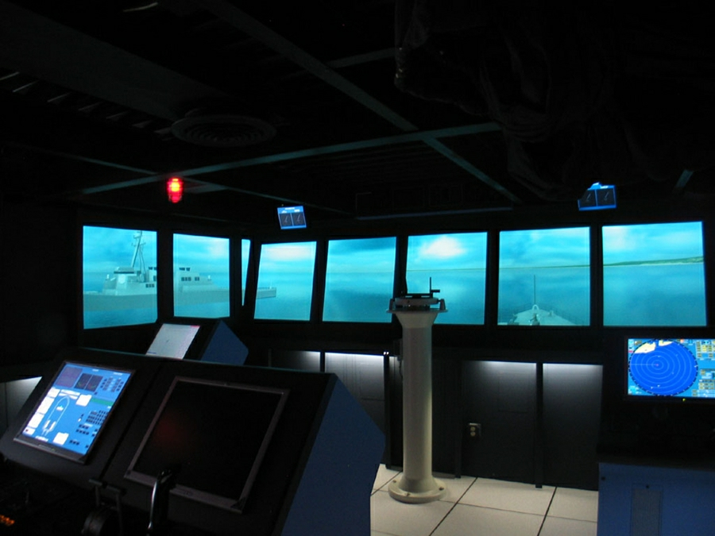
Serious Games
Training
Reduce classroom lecture
Promote active learning
US Navy VESSEL trainer

Slide 3
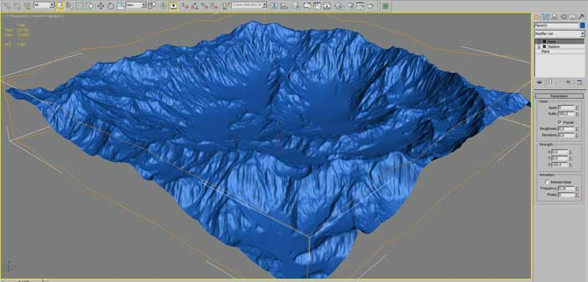
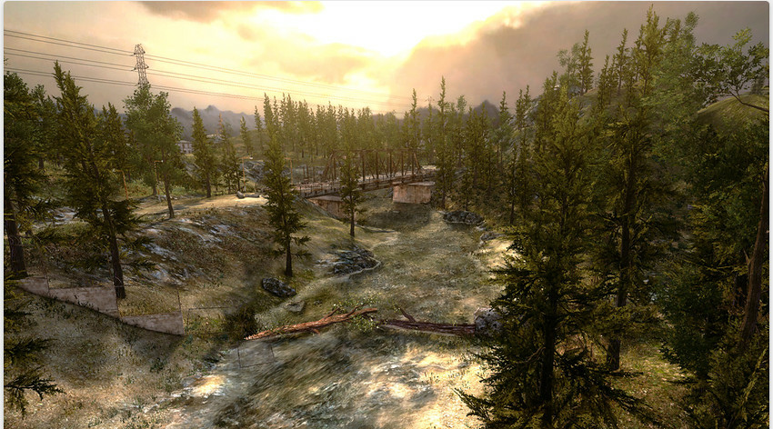
Game Engines
Simplify creating complex, realistic simulations
De-couples agent and terrain modeling and visualization (e.g., rendering, lighting, geo-typical terrain)
Notes:
…and cross-platform (e.g., Mac OS X, Windows, browser, and mobile platforms such as iOS, Android)

Slide 4
Problem
Every game engine has a scripting API
APIs allow control of all objects in the game
Game Engines are limited in their support for quickly and easily scripting behaviors of large groups of autonomous agents
Multi-Agent System (MAS) toolkits and simulators lack realism and features for spatial-aggregate programming
Spatial Computing
Scalable
Aggregate Control
Realism
Game Engines
MAS Toolkits
Notes:
Spatial-aggregate programming - enables scalable descriptions of aggregate behavior

Slide 5
Spatial-Aggregate Programming
Shibuya Crossing, Tokyo
http://www.youtube.com/watch?v=P5vuWJft32g
Notes:
Important because it’s sometimes impractical or impossible to describe every independent agent’s logic. Spatial specifications allow for scalable aggregate behavior descriptions.

Slide 6
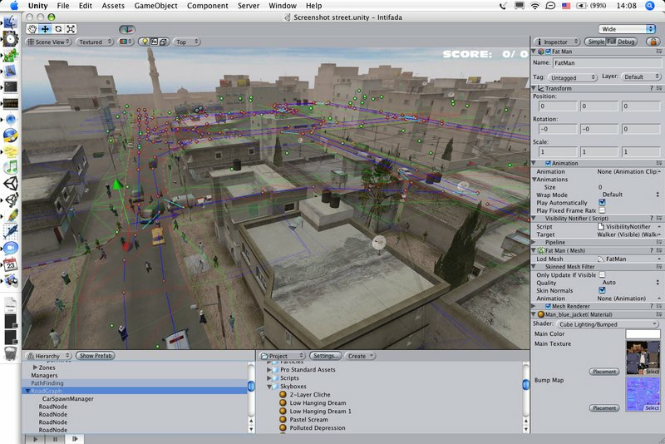
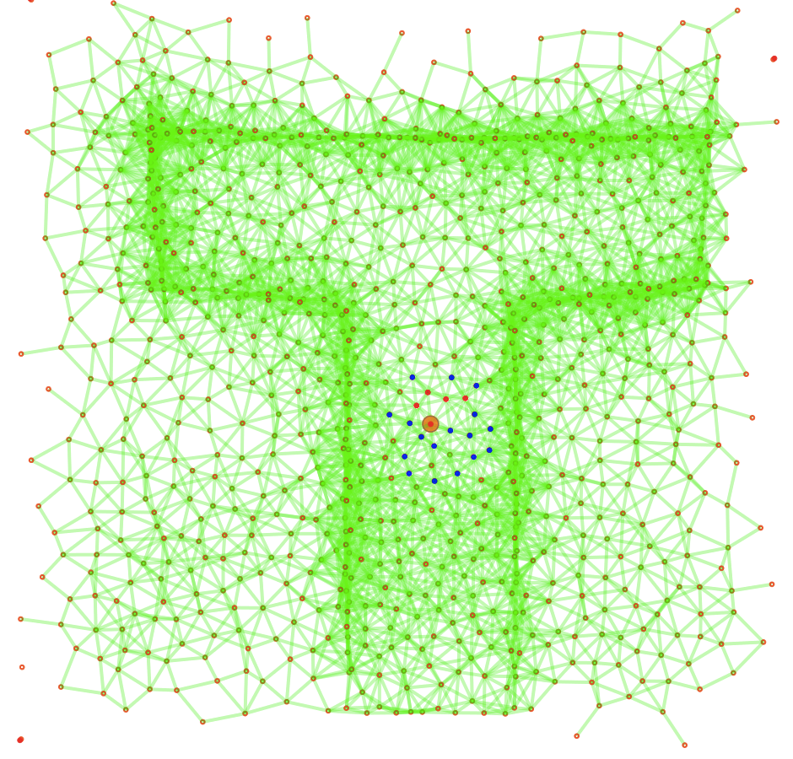
Solution
Combine modern game engine with spatial approach to scalable multi-agent behavioral scripting
roto

Slide 7
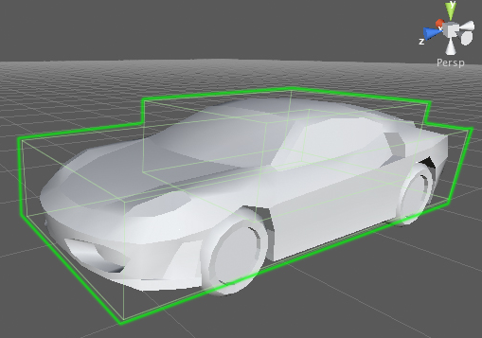
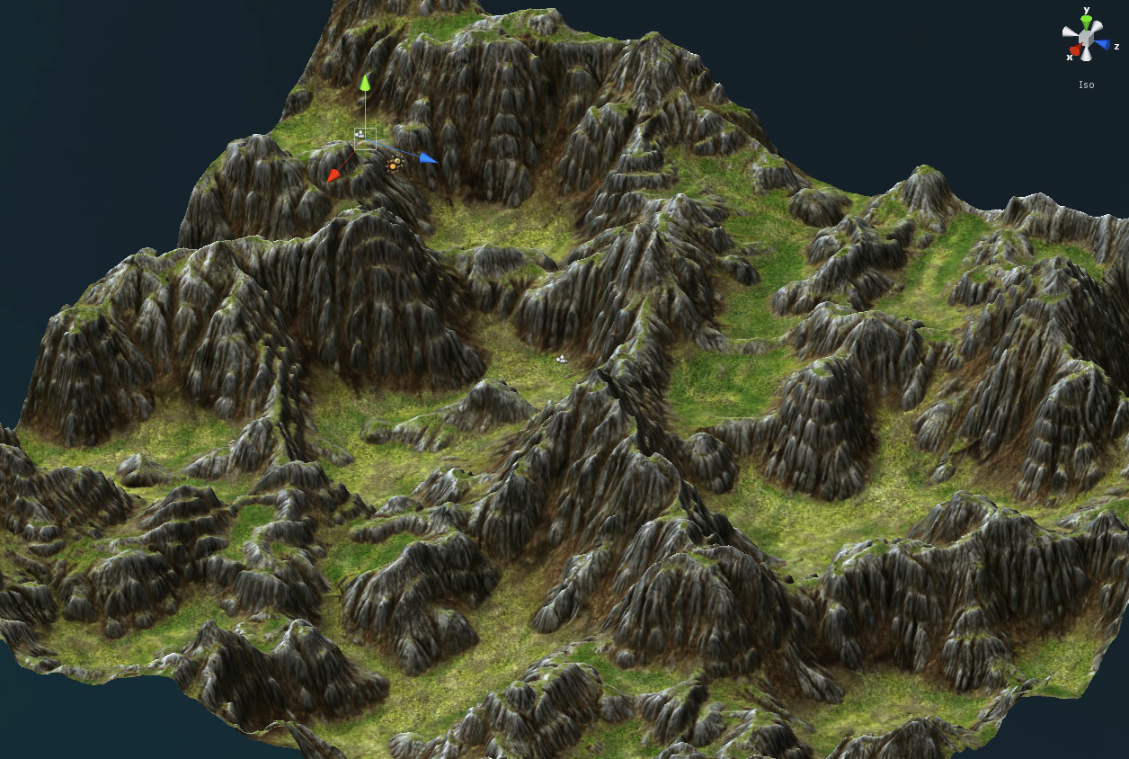
Unity
What is Unity?
Why Unity?
Realistic physics simulator
Simple/Realistic terrain modeling
Online market for “assets”
Notes:
Unity is an integrated authoring tool for creating 3D video games or other interactive content.
Unity has NVIDIA PhysX physics engine built-in.
Also has tools for making realistic (even geo-typical) terrain

Slide 8
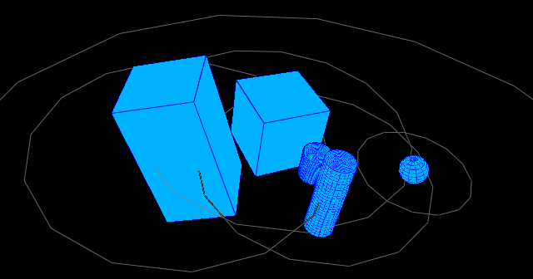
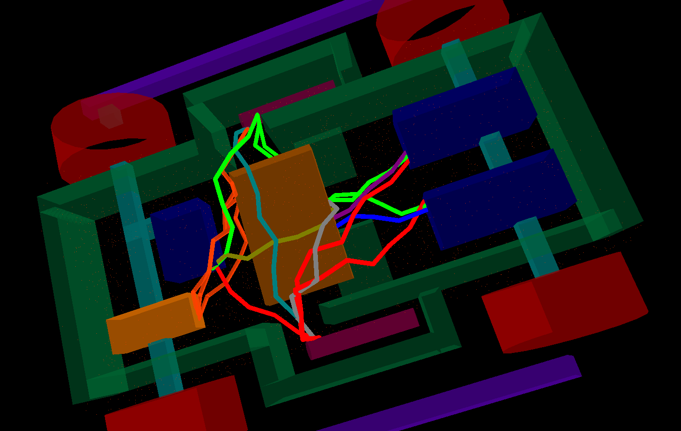
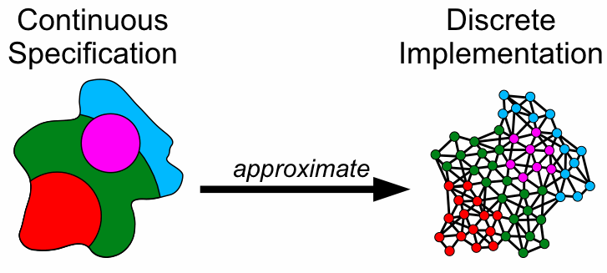
Proto
What is Proto?
Why Proto?
Global-to-local compiler
Extensible VM / Simulator Design
Notes:
Proto is a language and toolkit that makes it easy to write complex programs for spatial computers using a continuous space-time abstraction. Instead of describing every individual device’s behavior – envision the network as a continuous space with a device at every point and describe the behavior of regions of space.

Slide 9
Approach
Proto’s global-to-local compiler & VM
Unity’s simulation environment
Novel agent scripting library:
Group behavior primitives
Imperative-style scripting
Agent Scripting Library
roto
Notes:
Because game programmers are used to more imperative-style scripting environments, we created a Proto macro library.

Slide 10
Architecture
Agent Scripting Library
roto
roto Plug-in
Global-to-Local Compiler
Runtime Execution Loop
Proto Virtual Machine for Unity

Slide 11
Invoking the Proto Compiler
roto
Start the game
roto Plug-in
Global-to-Local Compiler
Send Proto program
to compiler
Proto byte-code
We designed a Unity plug-in for Proto that invokes Proto’s compiler, which in-turn creates byte-code to be executed by the virtual machine(s).

Slide 12
A Proto VM Implementation for Unity
We created a Unity plug-in that implements the required platform-speciﬁc functions from the Proto virtual machine reference implementation using tools from the Unity API.
roto Plug-in
Agent attributes
Runtime Execution Loop
Proto Virtual Machine for Unity
Temporal update, environmental changes

Slide 13
Agent Scripting Library
Agent Scripting Library
roto
We created an agent scripting library that extends the Proto language with group behavior primitives and imperative-style macros.

Slide 14
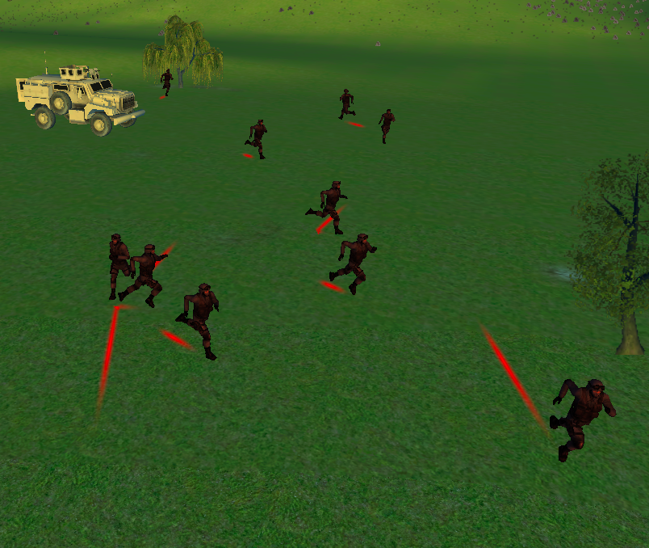
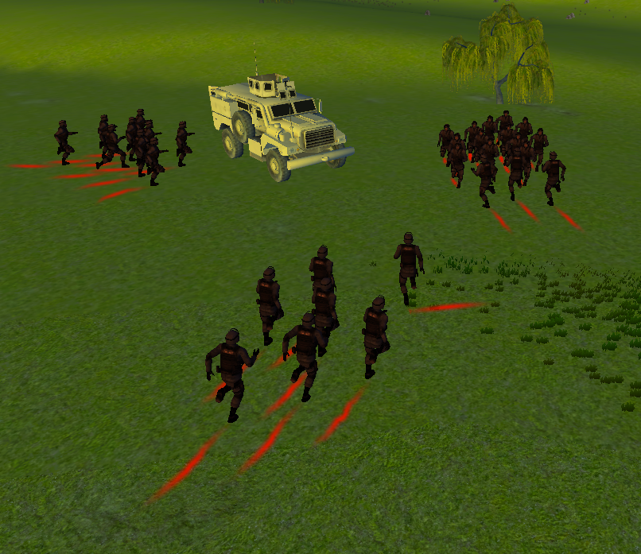
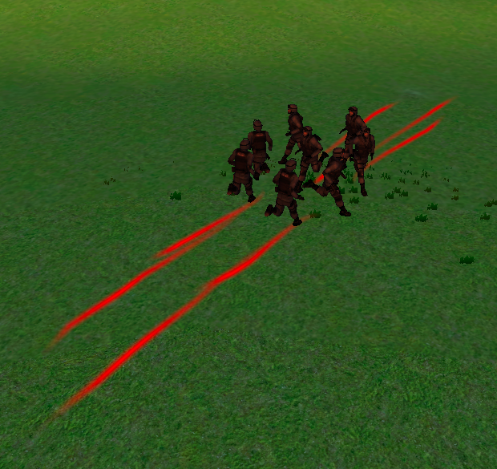
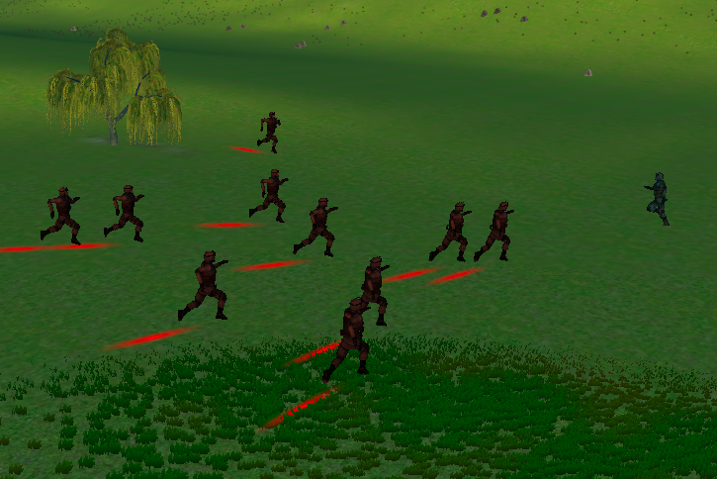
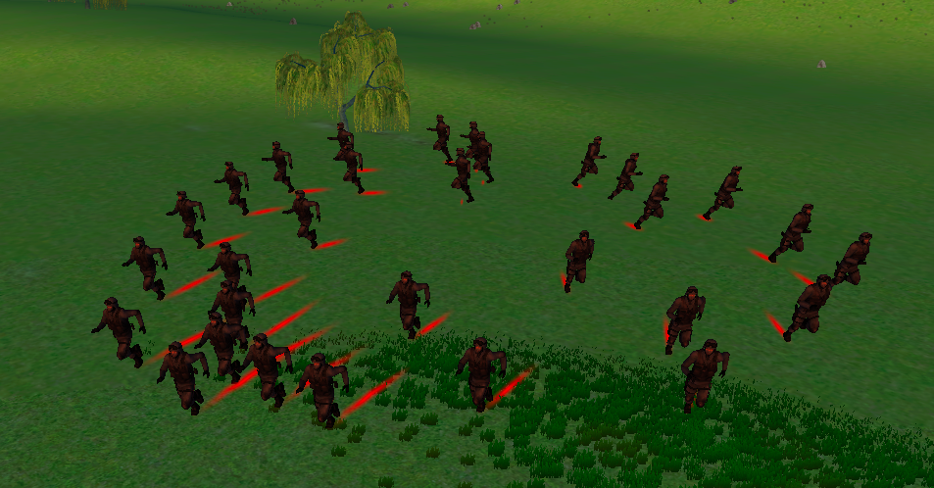
Group Behavior Primitives
Random Walk
Flock / Flock-to
Cluster-by
Toward
Disperse / Scatter
Notes:
We present the full API in the paper.

Slide 15
Imperative-Style Agent Scripting
Proto is a pure-functional language based on LISP.
Doesn’t map well to the typical agent scripting user’s imperative approach.

Slide 16
Imperative-Style Agent Scripting
Macro functionality added to Proto
Added macros to make Proto read more sequentially, event-driven, and/or behaviorally
(def red-advance (red-team blue-team)
(group-case
(behavior-of red-team ;; Red team behavior:
(where in-group
(flock-to (tup 0 0))) ;; go to Blue starting location
(behavior-of blue-team ;; Blue team behavior:
(on-trigger (can-see red-team) ;; when Red is near...
(scatter (away-from red-team))) ;; flee from Red!
(default (tup 0 0))))))
Notes:
Proto’s pure functional composition is mathematically elegant, but not what agent script developers are used to seeing.

Slide 17
Agent Scripting Library
(group-case
(behavior-of MEMBERSHIP-TEST BEHAVIOR
(behavior-of MEMBERSHIP-TEST BEHAVIOR
...
(default BEHAVIOR)...)))
(where TEST BEHAVIOR)
(priority-list
(priority NAME TEST BEHAVIOR
(priority NAME TEST BEHAVIOR
...)))
(on-trigger TRIGGER BEHAVIOR)
(sequence
([stage|group-stage] NAME ACTION TERMINATION
([stage|group-stage] NAME ACTION TERMINATION
...
[end-sequence|repeat])...))
Functional composition still applies!
Just a sampler... More to come!
Notes:
Group-case (like a case statement) defines variable in-group which is true for only those devices that are also part of the membership test.

Slide 18
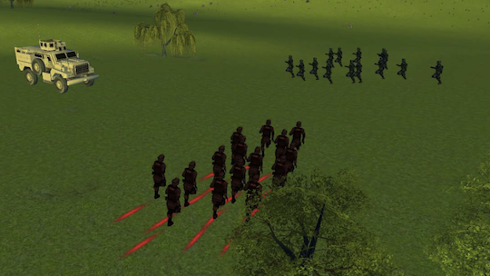
Example: Advance & Flee!
(def red-advance (red-team blue-team)
(group-case
(behavior-of red-team ;; Red team behavior:
(where in-group
(flock-to (tup 0 0))) ;; go to Blue starting location
(behavior-of blue-team ;; Blue team behavior:
(on-trigger (can-see red-team) ;; when Red is near...
(scatter (away-from red-team))) ;; flee from Red!
(default (tup 0 0))))))

Slide 19
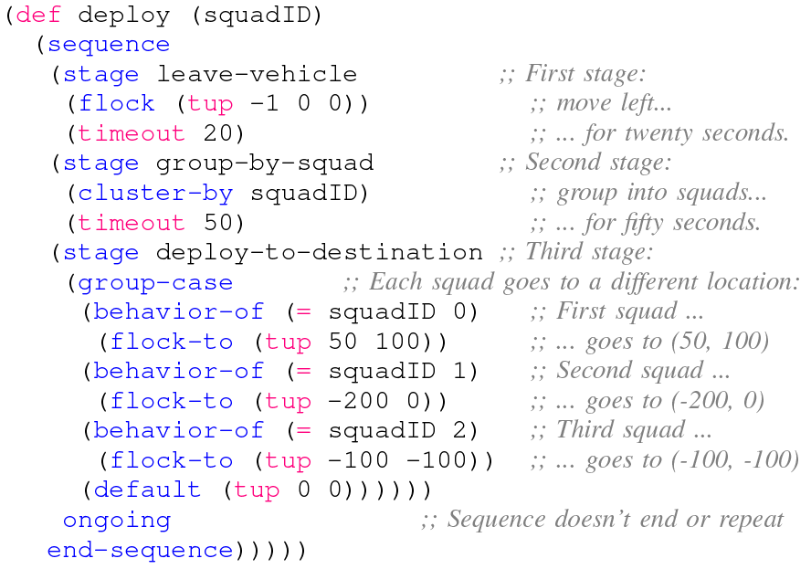
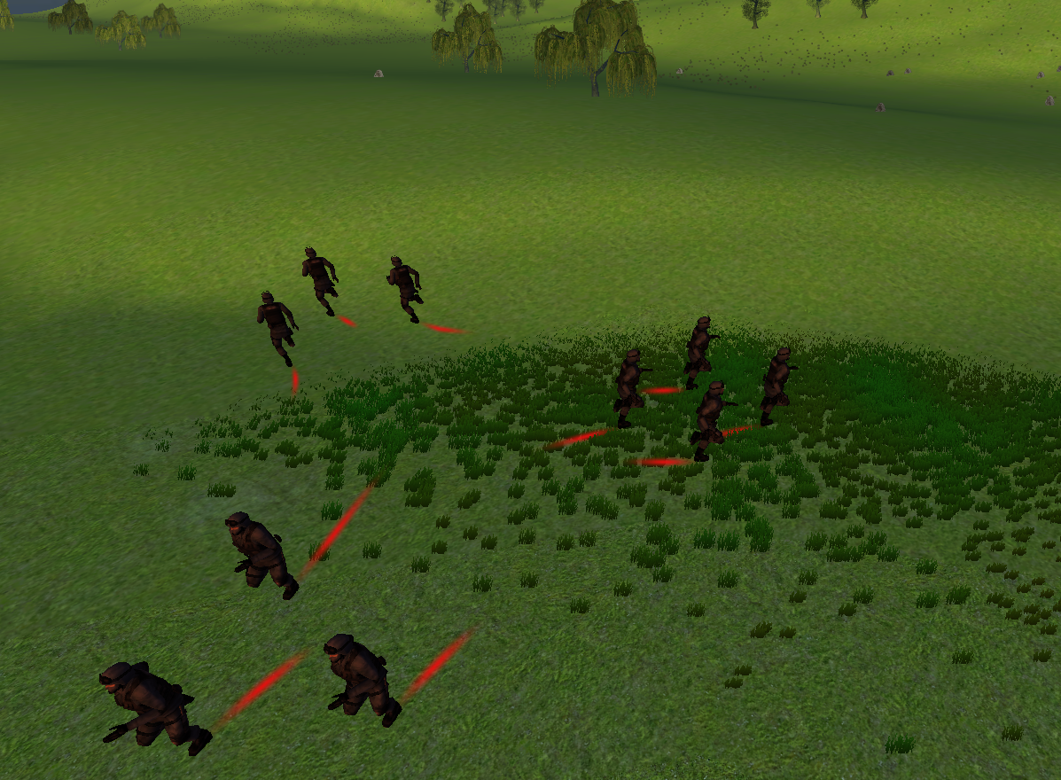
Example: Deploy

Slide 20
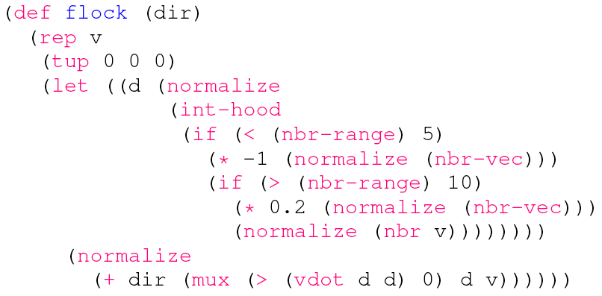
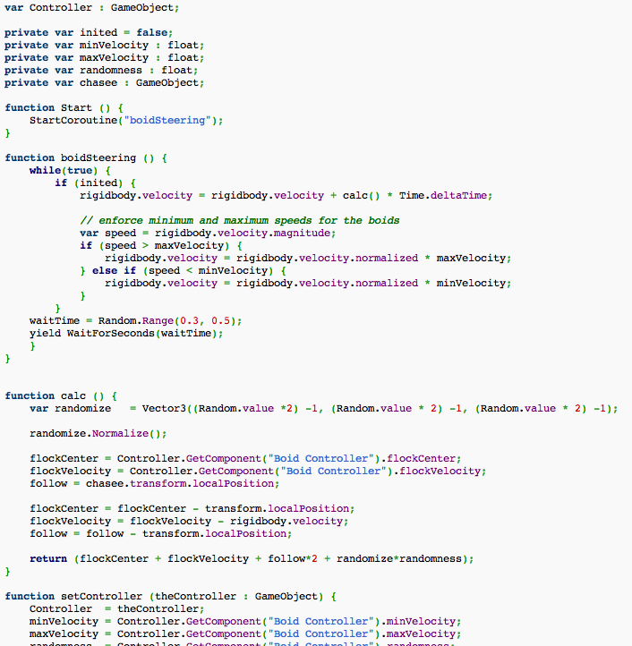
Code Comparison
Notes:
http://www.unifycommunity.com/wiki/index.php?title=Flocking

Slide 21
Benefits
Scalable
Supports large numbers of agents
Scripts remain constant with dynamic numbers of agents
Lightweight
Small memory and CPU profile
Realistic movement – agents are affected by their environment (e.g., collision, gravity, etc.)
Robust to behavioral changes – both during programming and during game-play

Slide 22
Future Work
Proto Plug-ins for Unity-specific operators / controls
Line-of-sight (including terrain obstacles)
Operator feedback (e.g., “Agent can’t run at 5 mph in that direction because it would be up a hill.”)
Adding to group behavior primitives and agent scripting library

Slide 23
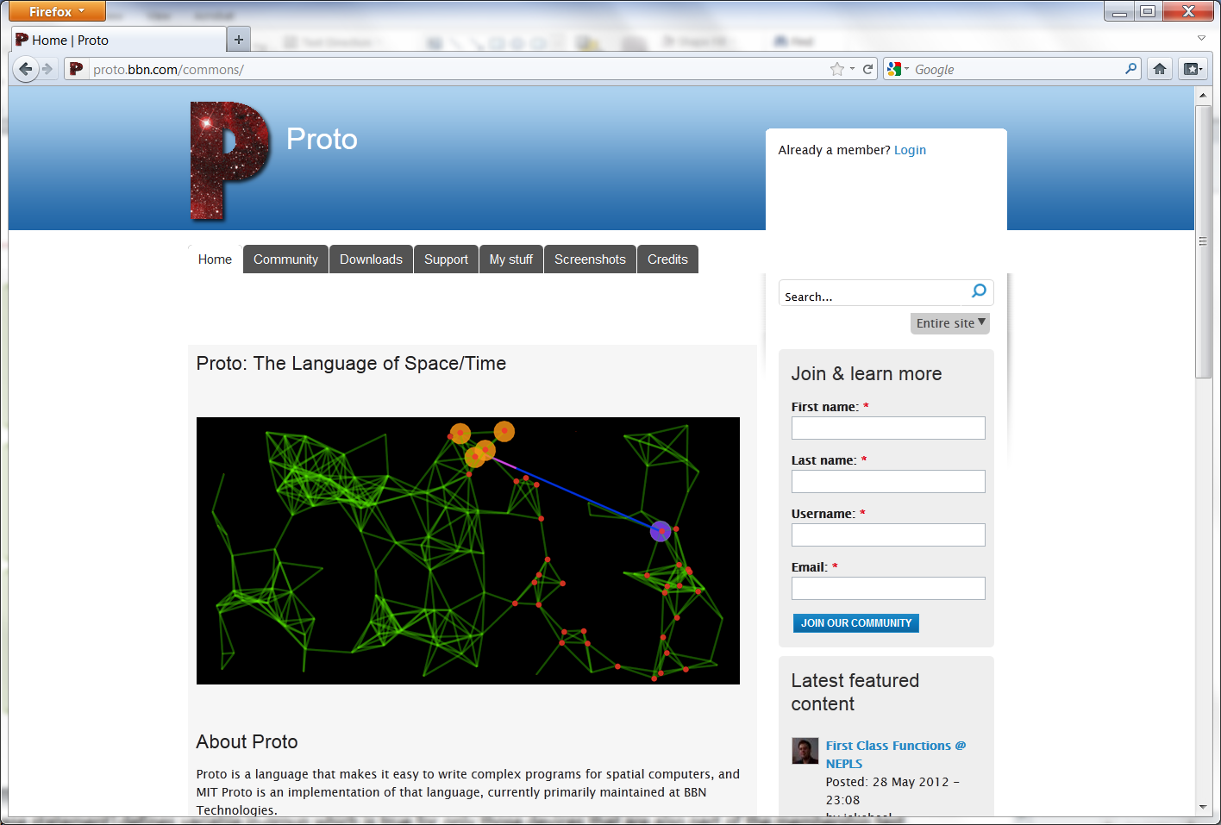
Join the Proto Community
http://proto.bbn.com

